Slide 1
Combining Fine-grained Font Recognition and OCR for Reading Historical Documents
By Souptik Sen

Slide 2
Content :
Problem Statement
Dataset Analysis
Data preprocessing
Methods
Training & Inference
Evaluation
Discussion
Conclusion

Slide 3
Problem Statement:
Massive volumes of meticulously scanned documents of various kinds are being published by libraries and archives. This creates the need for effective techniques to handle the volume of data. In many circumstances, researchers can benefit greatly from having the document content as a text file rather than an image file since it makes it easier for them to search for specific information. However, digitizing older means of documentation constitutes a more challenging task and requires significantly more effort. Books from this era frequently include font group changes that occur in the middle of lines or even words,indicating linguistic shifts and relevant time period information.
The main goal of this work is to combine fine-grained font group classification and OCR of early modern prints- documents printed between the 15th and the 18th centuries.

Slide 4

Dataset Analysis
We used 2,506 pages from 849 books published between the 15th and the 18th centuries to compile our data. Our data has been split at the book level so that no data from the same book can be present in both training and test sets.
We have considered eight distinct font groups which is a subset of two super font groups, namely Gothic and Roman. The font groups that compose the Gothic font groups are Bastarda, Fraktur, Rotunda, Schwabacher, and Textura. The font groups constituting the Latin font groups are Italic and Antiqua. We have also used Gotico-Antiqua, which falls halfway between Goth and Roman Latin fonts. Our dataset is constructed by splitting the pages of the books into small individual text lines
Example Line Image Having Multiple Fonts

Slide 5

Dataset Analysis ( continued..)
To compile our dataset we have used these individual text line images, which contain on average about 20 characters, along with information like text documents that include the contained ground truth text in the corresponding text line image and also pickled NumPy arrays that comprised the ground truth font group labels for individual characters in the corresponding text line image.
Here 1 denotes the Font Class of Antiqua and 5 denotes the font class of Schwabacher.
Ground Truth Text String of Example Line Image
Ground Truth Font Array of Example Line Image

Slide 6
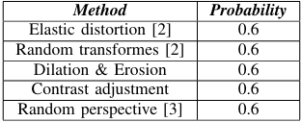
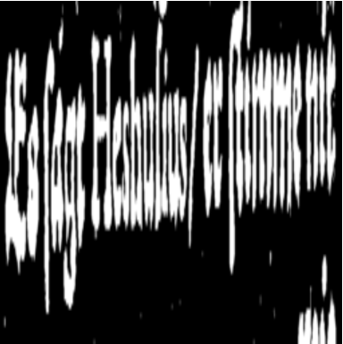
DataSet Preprocessing
The individual text line images are augmented using several random augmentation techniques, then binarized, and resized to a fixed height and width of 256 pixels to make the data usable for our model architecture. Binarization has been applied by utilizing the sauvola thresholding.
Overview of Random Data Augmentation Techniques for Visual Features
Fully processed Example line image

Slide 7
DataSet Preprocessing (Continued)
All the letters that appear in the dataset, combined with extra padding, end of sequence, and start of sequence tokens, are used to create the alphabet dictionary used for character tokenization.
For the ground truth text documents, each character of the text lines is tokenized by mapping them to their corresponding positions in the alphabet dictionary constructed by us. We also add the ’start of sequence’ and the ’end of sequence tokens’ to each tokenized text line for our machine to comprehend each text sequence separately.
Similarly, we also tokenize the font sequences by mapping each font class to a separate token signifying that particular font group. Every tokenized font sequence additionally has an ”end of sequence” token added to it. For every tokenized font sequence, we use the same token to signify the ’start of sequence’ and padding.

Slide 8
DataSet Preprocessing (Continued)
The augmented and processed line images are then provided with the ground truth text and font class information.These individual line information are then stacked together into batches of data. Since we are dealing with a sequence of images, sequence padding is applied to the images to ensure uniform length along the sequence or temporal dimension, assisting efficient batch processing in our model.
Due to shape dependencies of our Handwritten Text Recognition model, the batches of ground truth text and font sequences also have to be padded to a fixed sequence length matching the longest corresponding sequence for each batch. This is done by adding extra padding tokens after ’end of sequence’ tokens for the tokenized batches of text and font sequences.
It is important to note that we have used both single font line images and multiple-font line images collectively for training and validating our model.

Slide 9
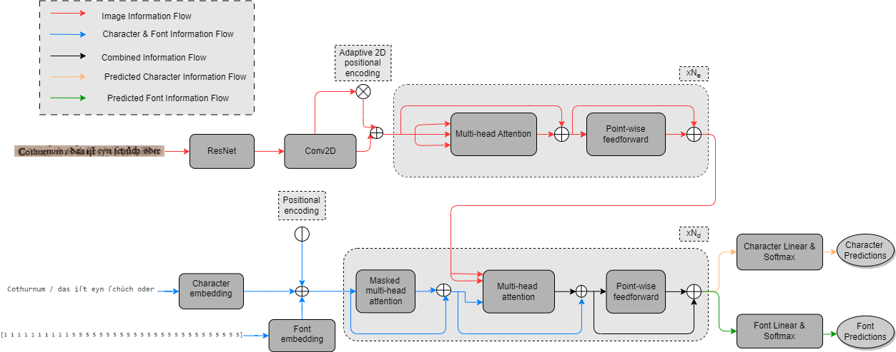
Methods
We have used an entity transformer model to jointly perform Handwritten Text Recognition and fine-grained font recognition for the recognized characters.
Architecture of the transformer HTR model

Slide 10
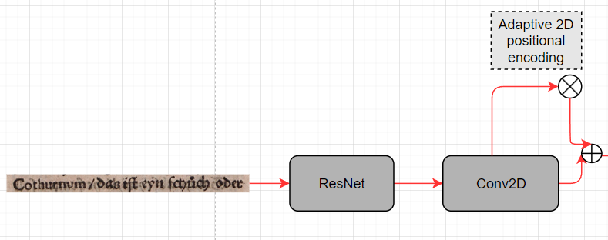
Visual Feature Extraction
Firstly the line image is fed into a pre-trained ResNet 18 model for extracting the visual features. This reduces the high computational cost of the self-attention layers inside the encoder module of the entity transformer, putting more emphasis on the sequence part. To make the 2-dimensional feature maps accessible by the transformer encoder, the next step is to squeeze them into a sequence that matches the encoder input dimension. This is done by applying a 2D Convolutional layer on the feature map output of the ResNet-18 model.

Slide 11

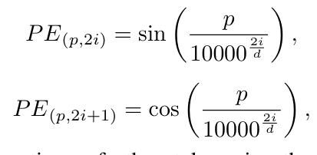
Visual Feature Extraction(continued..)
Before reshaping the feature maps to a sequence, a positional encoding must be added to them, due to the positional invariance of the self-attention layers.
Our dataset consists of highly cursive writing. We have employed the adaptive 2D positional encoding to the extracted feature maps to be more robust to highly cursive writing. Based on the feature map and learned weights, a scaling parameter will be computed for each spatial dimension (α, β). The positional encoding is then added to the feature map F using these values:
The sinusoidal positional encoding applied for each dimension can be represented by the following equations:
Here p and i are the indices of the position and the hidden dimension, and D is the size of the hidden dimension or embedding dimension of our model.

Slide 12
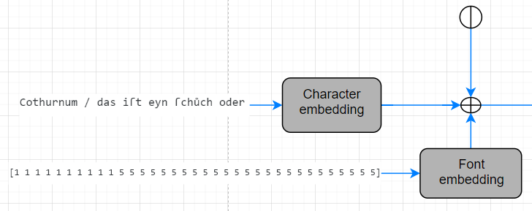
Character & Font Fusion
The target sequence utilized in our model architecture is comprised of the character and font sequences. The character logits and the font logits bear positional dependency with each other, i.e. for every character logit, there is a corresponding font logit. To preserve the positional interdependency of the character and font sequences, it is crucial that we carefully consider how to concatenate them for the machine to interpret. The positional interdependence is destroyed if the concatenated sequence is flattened to fit the decoder input dimension. Thus we come up with a different approach to fuse the character and font information.

Slide 13
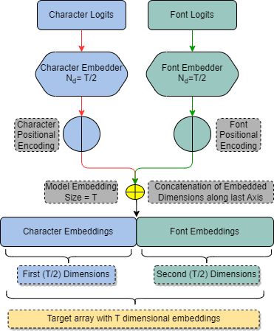
Character & Font Fusion ( continued)
Two separate embedding layers have been used, one for character embedding and another for font embedding. The target character logits are embedded into a higher dimensional space by using the character embedder. Similarly, the font class logits from the target sequence are also embedded into a higher dimensional space by the font embedding layer.
Our model’s total embedding or hidden dimensions, T, are divided into two T/2 dimensional embedding spaces, one for character embedding and one for font embedding. Ultimately, after positional encoding, these embeddings are concatenated along our target sequence’s last axis, resulting in character embeddings for the first T/2 dimensions and font embeddings for the next T/2 dimensions.

Slide 14
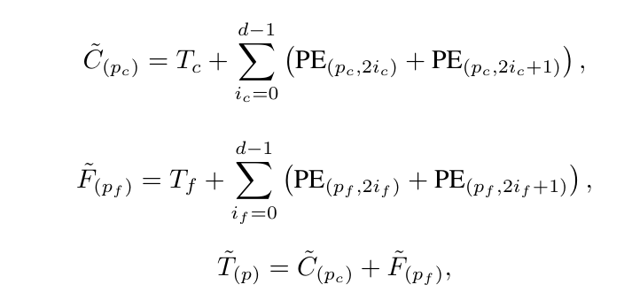
Character & Font Fusion( continued..)
Again, due to the positional invariance of the self-attention layers in the decoder module, we have to add sinusoidal positional encoding to the two T/2 embeddings separately before concatenating them.The sinusoidal positional encoding applied can be represented by the following equations:
Here, the location of the token in the sequence is denoted by p, the dimension by i, and the dimensionality of the positional encoding by d. For our model, the dimensionality of the positional encoders can be expressed by d =dfont = dchar = T/2

Slide 15
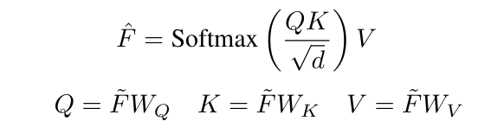
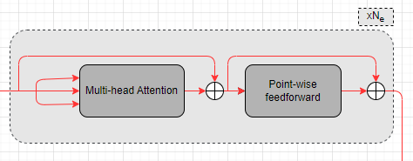
Visual Feature Refinement in Encoder
To further condense the visual information the transformer encoder module is applied Ne times on the flattened output of ˜ F. The multi-headed self attention layer is employed there; the following equation does not depict the splitting into several heads for simplicity’s sake:
In this context, the query (Q) is determined by the feature map (˜ F) multiplied by the parameter matrix (WQ), the key (K) is derived from ( ˜ F) using the parameter matrix(WK), and the value (V ) is computed as ( ˜ FWV ) using the parameter matrix WV . A point-wise feed-forward layer is attached to the attention mechanism, which is used for further refinement of ˆ F.

Slide 16

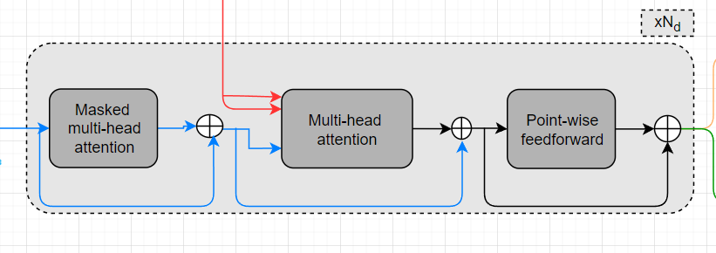
Visual ,Text and Font Information Fusion in Decoder
Character and Font Information Flow in decoder: The Transformer Decoder layer will be applied Nd times on the fused character and font embeddings ˜ T. Here, the multi headed self-attention is applied on ˜ T to condense the context information. Thus, like the final visual vector ˆ F we get a vector ˆ T by applying the attention equations to ˜ T.
Fusion: In the following step, inside the Transformer Decoder, the mutual attention layer fuses the visual information ˆ F with the textual and font information ˆ T by setting, , and applies the same formula as in the attention equation.

Slide 17
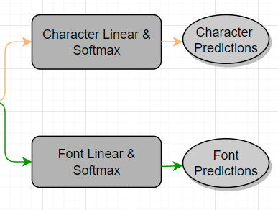
Text and Font Prediction
After running through the transformer decoder multiple times the output sequence having dimensions T is split along the last axis to get two sequences that have T/2 dimensions in their last axis. The first sequence forms the predicted character sequence, which is then fed to a linear layer to match the alphabet vocabulary size and then finally passed through a softmax layer to get the probability scores of the next character. The second sequence yields the predicted font class sequence, which is then fed to a separate linear layer to match the font class vocabulary size and then ultimately passed through a softmax layer to get the confidence scores of the font class of the next predicted character.

Slide 18
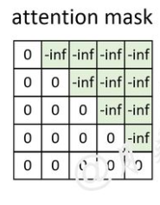
Training & Inference
In order to shorten the training period, this step can be parallelized by masking the target or decoder’s input sequence’s unseen segments during training. We refer to this as teacher forcing.
Teacher forcing during training leads to a problem when dealing with lower amounts of data, like historical documents, since the model quickly overfits the input target or decoder sequence without incorporating the visual features in the mutual attention layers. Therefore, during training and validation, we decided to perturb the input sequence of the decoder to make the model more robust to predicted errors and to force the model to rely more on the encoder features.

Slide 19
Training & Inference(contd..)
In our work, we have employed two distinct Smooth cross-entropy loss functions: one for font prediction and the other for character prediction. During backpropagation, the model is trained to simultaneously optimize both character prediction and font class prediction by adding these two losses multiplied with their appropriate weights,Weight(char) and Weight(font), and logging the cumulative total loss for backpropagation. To ensure that the model gives equal importance to both font class prediction and character prediction, we have set both weights for our loss function to a value of 1.
It should be noted that during inference, the model predicts the outputs in an auto-regressive manner without the use of teacher forcing. In other words, the model receives the start-of-sequence token for character prediction inference and the padding sequence token for the font classification inference in the first iteration and adds the best fit of each prediction to the sequence until an end-of-sequence token appears.

Slide 20
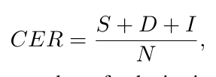
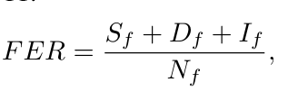
Evaluation (metrics)
CER : The character error rate (CER), is a frequently used metric for quantifying the qualitative image to-text prediction performance.
Here S denotes the number of substitutions, D is the number of deletions, and I is the number of insertions, which is basically the Levenshtein distance between the predicted text sequence and the ground truth text sequence. This is divided by the number N of characters in the ground truth text.
FER : The second metric that is collected is the Font Error Rate, which is the same as the CER but on the font group classification level.
Here Sf denotes the number of substitutions, Df is the number of deletions, and If is the number of insertions, which is basically the Levenshtein distance between the predicted font class sequence and the ground truth font class sequence. This is divided by the number Nf of elements in the ground truth font class sequence.

Slide 21
Evaluation (metrics)
Font Precision : A precision metric has also been used for quantifying the font group classification.

Slide 22
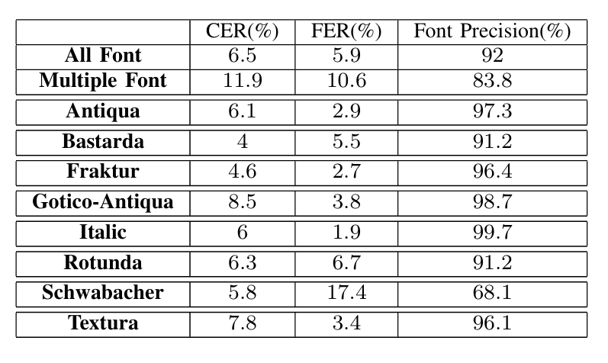
Evaluation (Results)
Our tests were conducted on line images from completely unseen early modern print books. Ten experiments were performed: one for multiple font line images, one for line images having both multiple font, and specific single font cumulatively i.e. for all the line images, and eight other tests were performed for every individual type of single font images.

Slide 23
Evaluation (Results)
Prediction of the example line image can be seen below:

Slide 24
Discussion
It is interesting to note that an additional test was performed on the cumulative dataset i.e. the dataset with line images having both multiple font, and specific single font cumulatively i.e. all the line images. In this test, for font classification, the model was not allowed to use its past predictions auto-regressively to predict the target font class sequence. In other words, the model was not provided with its font class predictions of previously predicted characters to predict the font class of the current character. Instead, the model was forced to depend only on the visual features for font classification and not its previous outputs.
In this test, we got a font precision of 89.8%, a FER of 10%, and a CER of 6.5%. From this, we can infer that our model correctly identifies that for font classification of characters, it has to focus more on the visual features of the characters in the text line images, rather than their semantic or sequential dependencies.

Slide 25
Conclusion
In conclusion, it can be said that our approach shows promising results in combining Optical Character Recognition with Font recognition to read historical documents. The approach proposed in this work can be explored in other natural language processing tasks as well, which require a model to predict multiple variables at the same time, and can certainly be included in future works.

Slide 26


